Slide 1
Little Miss Busy
Time Words

Slide 2
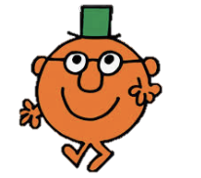
What is a time word?
Time words are words or phrases which are used to tell a reader when something is happening.

Slide 3
When do we use them?
We often use them in instructional writing and recounts.

Slide 4
For example!
-First cut the fruit.
-Next mix in the sugar.
-After that add the milk.

Slide 5
Can you find the time words?
-First cut the fruit.
-Next mix in the sugar.
-After that add the milk.

Slide 6
Which sentences have time words in them?
-After put the cake mix in the oven.
-Finally eat the cake.
-put the fruit in the mix.

Slide 7
Can you add time words to these sentences?
-Put the bun mix in the bowl.
-Eat the buns.
-Add the sweets.

Slide 8
Can you think of any other time words?

